Slide 1
Overview of software testing
Lecture 4

Slide 2
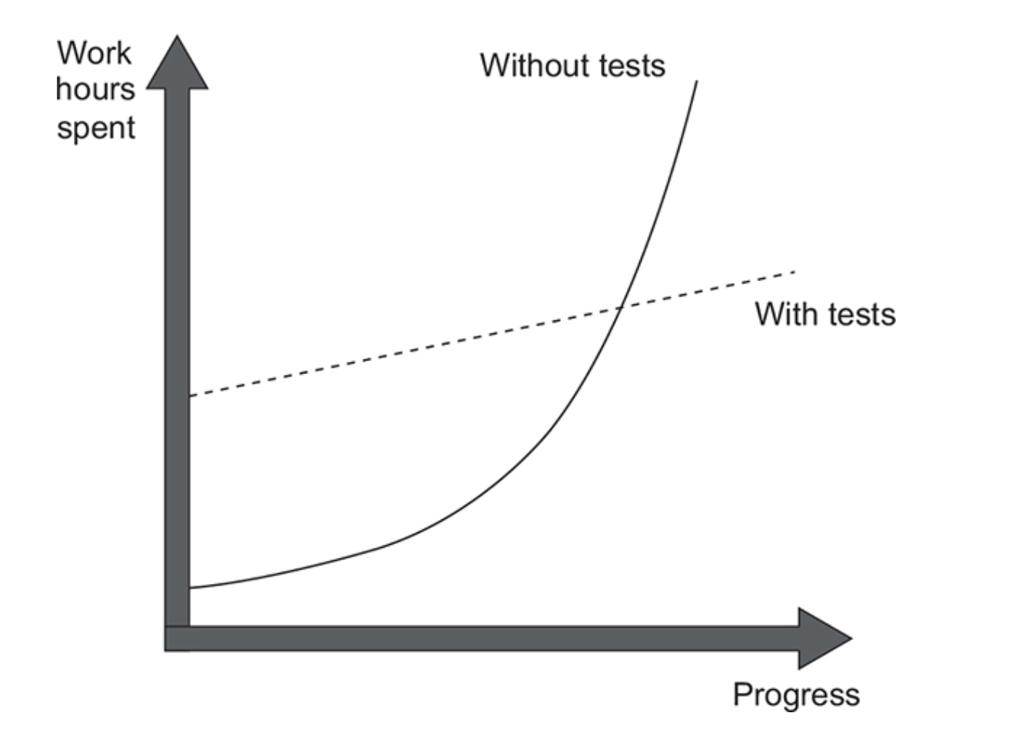
What is software testing and why is it important?
“Computers are good at following instructions, but not at reading your mind.“— Donald Knuth
Software testing is the process of verifying and validating that a software product meet the requirements.
Why is software testing important?
Product Quality
It makes software more reliable and easier to use
It improves performance
It helps keep product quality throughout team changes
Customer satisfaction
It discovers defects/bugs before the delivery to the client
It promises superior user experience
Cost-effectiveness – bugs discovered earlier are cheaper to fix
Security – it helps identify security vulnerabilities

Slide 3
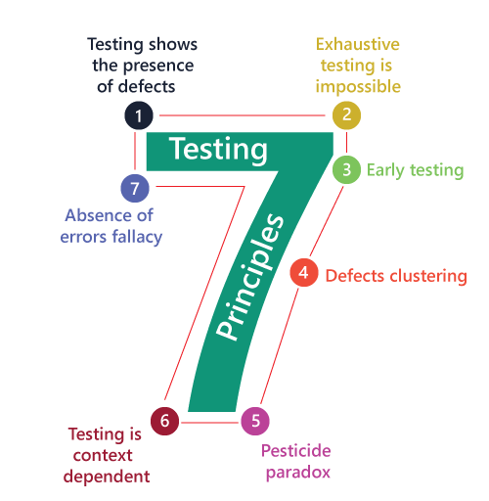
Software testing principles
Testing shows the presence of defects - Software testing talks about the presence of defects and doesn’t talk about the absence of defects.
Exhaustive testing is not possible - software can never test every test case and even if it did, that would take too much time & effort – it would be impractical
Early Testing - a defect detected in early stages will be very less expensive
Defect clustering - a small portion of the code could contain most of the defects (80/20 Pareto Principle)
Pesticide paradox - repeating the same test cases on the same software will not reveal new bugs
Testing is context-dependent - different types of software need different types of testing
Absence of errors fallacy - If a software is 99% bug-free, but it does not follow the user requirements, then it is unusable

Slide 4
Testing guidelines
Start as early as possible – start parallelly alongside the requirement analysis process
Prioritize sections – most critical sections should be prioritized
Keep in mind that the testing time for software is limited – testing deadlines, completion of test cases, code coverage to a certain point, budget limits, bug rate below a certain level etc.
Testing should be done with correct/expected data and test cases as well as with flawed/unexpected test cases
Testing should be done throughout the Software Development Life Cycle – from the requirements phase till the implementation phase and even beyond

Slide 5
Software testing lifecycle (STLC)
Requirement Analysis
Test Planning
Test Case Development
Environment Setup
Test Execution
Test Case Closure

Slide 6
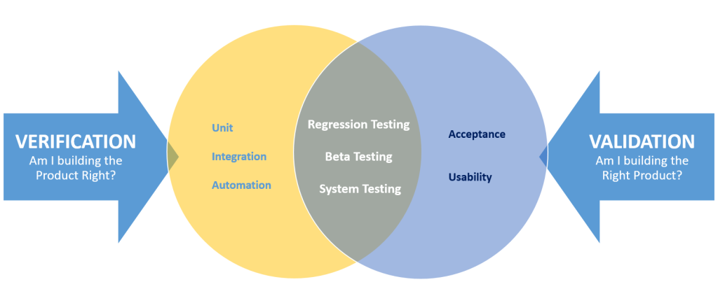
Verification vs Validation
Verification: involves evaluating whether the software product conforms to its specified requirements
Validation: involves evaluating whether the software product satisfies the customer's or user's actual needs and expectations.
...verification determines whether the product was built right, while validation determines whether the right product was built

Slide 7

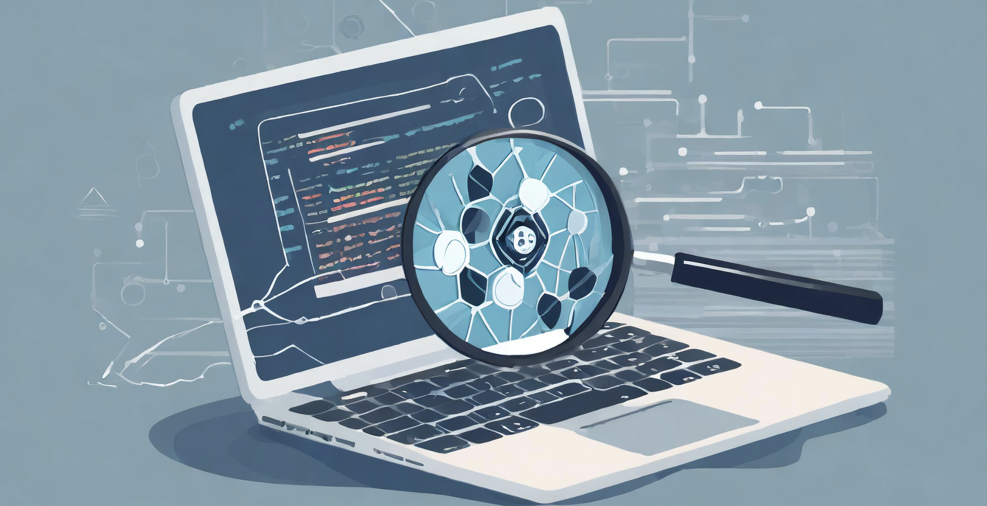
Types of software testing
MANUAL TESTING
Testing software manually, without using any automated tool or any script
The tester takes over the role of an end-user and tests the software to identify bugs or unexpected behaviors
AUTOMATED TESTING
When the tester writes scripts and/or uses another software to test the product
Used to re-run the test scenarios that were performed manually, quickly, and repeatedly

Slide 8
Software Testing Methods
Black Box Testing
The internal structure/design/implementation of the software is not known to the tester
No knowledge of programming is required
It is the behavior testing of the software (based on external expectations)
It is least time consuming
Grey Box Testing
The tester has limited knowledge of the internal structure/design/implementation of the software
Based on high-level database diagrams and data flow diagrams
Partially time consuming
White Box Testing
The internal structure/design/implementation of the software is known to the tester
Knowledge of programming is mandatory
It is the logic testing of the software
It is most time consuming

Slide 9
Levels of software testing
Unit Testing
Individual units/components of a software are tested
Integration testing
Individual units/components are combined and tested as a group
System testing
A complete/integrated system is tested
Evaluates the system's compliance with the specified requirements
Acceptance testing
The system is tested for acceptability
Evaluates compliance with the business requirements and assesses whether it is acceptable for delivery

Slide 10


Functional / Nonfunctional Testing
Functional Testing
Check if the app meets the business requirements
Test user actions
Test the functionality
Define what to test
Non-functional Testing
Check if the app meets the customer expectations
Test the response time, speed
Test how the functionality is performed
Define how to test

Slide 11
Unit testing
Unit tests are small pieces of code that perform one, specific task
Because unit tests are small, unlike integration tests, unit tests do not communicate over the network, do not perform database operations etc.
Unit testing objectives
Unit tests enable sustainable growth of the software project. It's easy to grow a project when you start from scratch. It becomes harder and harder to sustain this growth over time
Software entropy manifests in the form of code that tends to deteriorate each time you write new code. And fixing one bug may introduce new bugs. Unit tests help overturn software entropy by acting as a safety net against a vast majority of regressions.

Slide 12

Unit testing
A regression is when a feature stops working as intended after a certain event (usually, a code modification). The terms regression and software bug are synonyms and can be used interchangeably.
Types of unit testing: Manual and Automated
Commonly used unit testing tools: xUnit, JUnit, PHPUnit etc
What makes unit tests good or bad?
It is not enough to write unit tests. Badly written unit tests are just as useless as having no unit tests.

Slide 13
Unit tests best practices
Test environment: Unit tests are developed, executed, and maintained separately from the production code.
Naming Convention:
Package Naming Convention: The package of the test class should match the package of the source class.
Test Case Naming Convention: Users should understand the behavior and expectation of the test from the name itself.
Keep tests clean: Test code is just as important as production code. Test code must be simple, succinct and expressive. If we don't keep tests clean, they will become harder to maintain and may decide to discard them entirely.
One Assert/Single Concept per Test: Minimize the number of asserts per concept and test just one concept per test case.
Avoid Code Redundancy: Use helper functions to mock data and external services for similar test concepts.

Slide 14
Unit tests best practices
F.I.R.S.T.:
Fast: Tests should run quickly - in order to run them frequently and fix problems as soon as possible.
Independent: Tests should not depend on each other. Dependencies between tests make diagnosis and bug fixing difficult.
Repeatable: Tests should be repeatable in any environment.
Self-Validating: Tests should have a boolean output (PASS/FAIL). Unit tests should not require manual evaluation.
Timely: Unit tests should be written together with the production code. If we postpone unit tests, we may decide that some production code is too hard to test, we may not design the production code to be testable.

Slide 15
Boundary testing
What is Boundary Testing?
A software testing technique that focuses on testing the boundaries or extremes of input values, parameters, or conditions.
Why is Boundary Testing Important?
Identification of Edge Cases: Helps identify potential errors or vulnerabilities that may arise at the boundaries of input ranges.
Enhances Software Robustness: By validating the handling of boundary conditions, the software's robustness and reliability are improved.
Improved Quality Assurance: Boundary testing contributes to overall quality assurance efforts by uncovering defects that might otherwise go unnoticed.

Slide 16
Boundary testing - example
Problem:
We have a thermostat for a heating system that controls the temperature in a room, and we need to perform boundary testing to ensure it functions correctly in various scenarios.
Lower Limit: The minimum temperature setting is 10 degrees Celsius.
Upper Limit: The maximum temperature setting is 30 degrees Celsius.
Solution:
Lower Limit (10 degrees Celsius):
Set the thermostat to the minimum temperature of 10 degrees Celsius.
Monitor the room temperature to check if the thermostat maintains it at 10 degrees Celsius.
Verify if the heating system is activated to maintain the minimum temperature.
Set the thermostat to 11 degrees Celsius and observe if the heating system remains inactive, ensuring it behaves appropriately just above the lower limit.
Upper Limit (30 degrees Celsius):
Set the thermostat to the maximum temperature of 30 degrees Celsius.
Monitor the room temperature to check if the thermostat correctly stops the heating system when it reaches the upper limit.
Verify if the temperature remains constant at 30 degrees Celsius.
Set the thermostat to 29 degrees Celsius and observe if the heating system remains active, ensuring it behaves appropriately just below the upper limit.

Slide 17
Software testing myths
Tests can't be wrong
The more tests, the better
Testing is time consuming
Testing is too expensive
The truth?
Test code is code too.
It must be tested. It may have bugs.
It depends on how relevant the test code is/how much code it is covered.
During the SDLC, testing is not time consuming. However, diagnosing and fixing errors afterward...
Early testing saves time and cost in many aspects

Slide 18


Slide 19
Testing in the wild
Popular open source projects have a large test suite that is visible in the Github pull requests:
Curl: https://github.com/curl/curl/pulls
Spark: https://github.com/apache/spark/pulls
Airflow: https://github.com/apache/airflow/pulls

Slide 20
Software Engineering Lore
https://www.softwaretestingmaterial.com/software-testing/
https://www.ibm.com/topics/software-testing
https://www.geeksforgeeks.org/
https://goodpractices.home.blog/2019/11/27/verification-validation/
https://livebook.manning.com/book/unit-testing/ - "Unit Testing Principles, Practices, and Patterns", Vladimir Khorikov
https://learning.oreilly.com/library/view/clean-code/ "Clean Code - A Handbook of Agile Software Craftsmanship", Robert C. Martin - Ch.9 Unit Tests
https://learning.oreilly.com/library/view/spring-start-here/ "Spring Start Here", Laurentiu Spilca - Ch.15 Testing your Spring app
https://learning.oreilly.com/library/view/junit-in-action/ "JUnit in Action", Catalin Tudose
https://www.guru99.com/equivalence-partitioning-boundary-value-analysis.html
https://www.guru99.com/integration-testing.html#1
https://www.softwaretestinghelp.com/what-is-integration-testing/

Slide 21
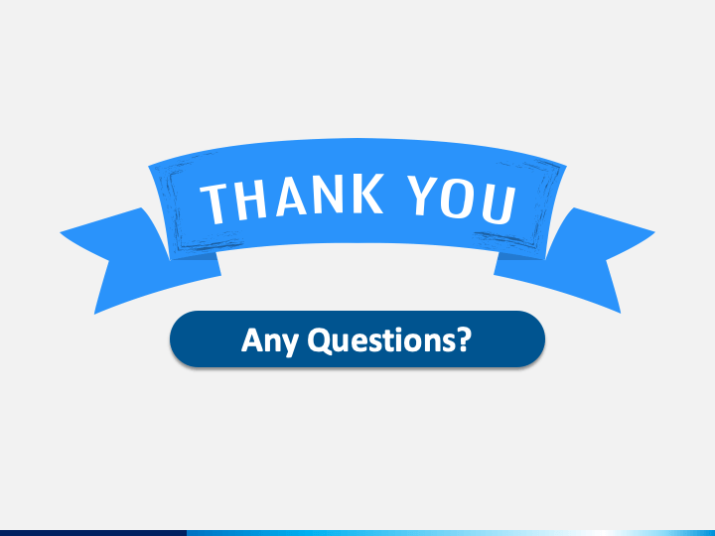
21

